Slide 1



System Driven Hardware Design
25 Ghz RADAR - Movement Detection
Soumya Ranjan Sabat: 127993 Akarsh Vijetha Raj: 1127916
Group: D5

Slide 2
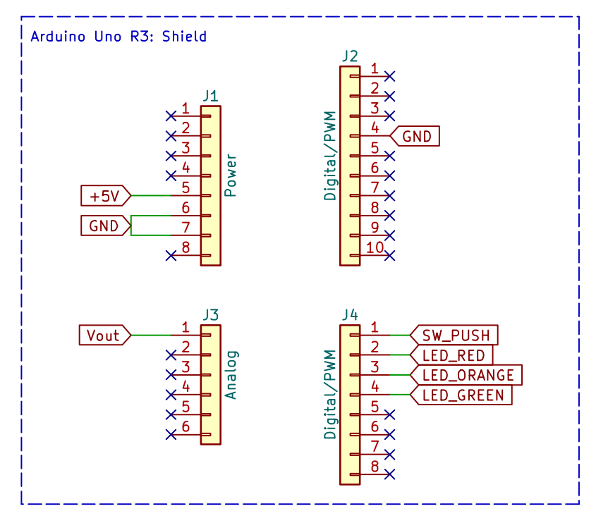
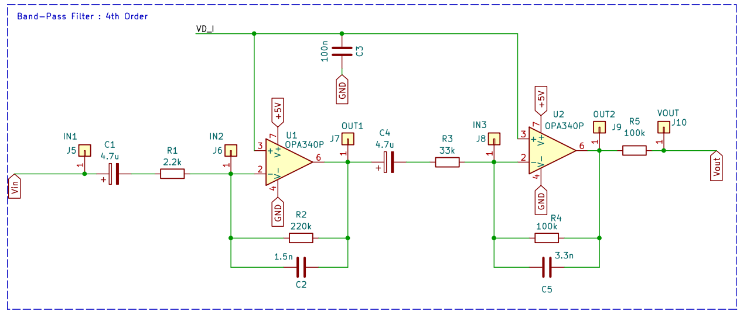
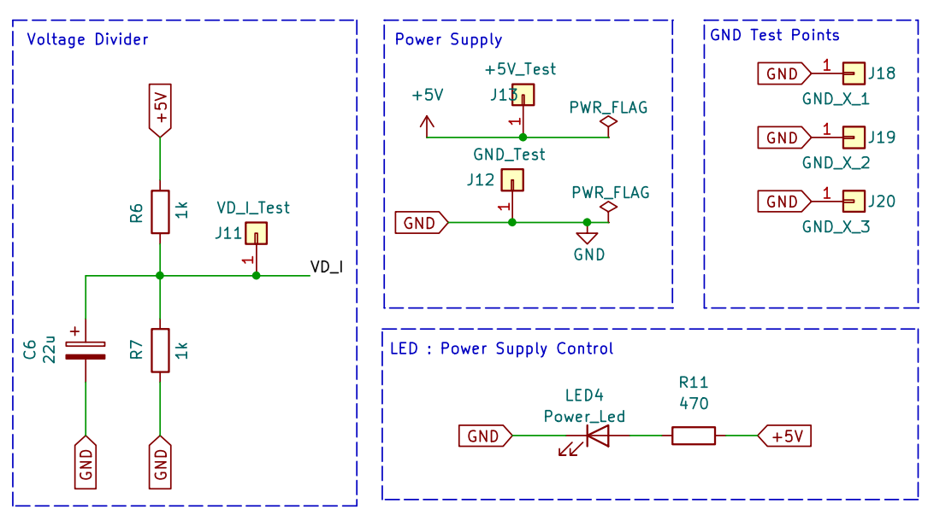
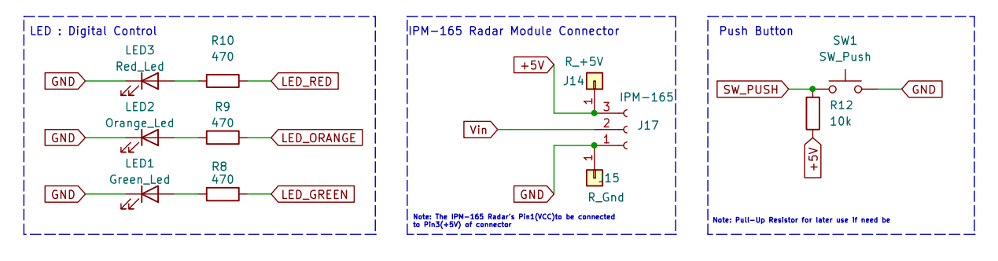

Slide 3
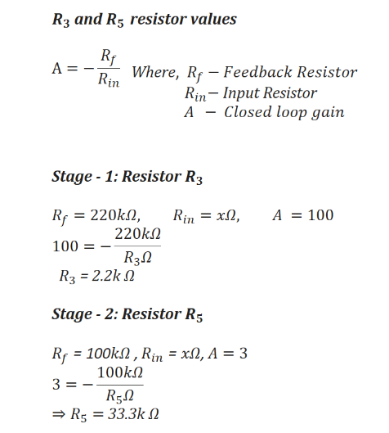
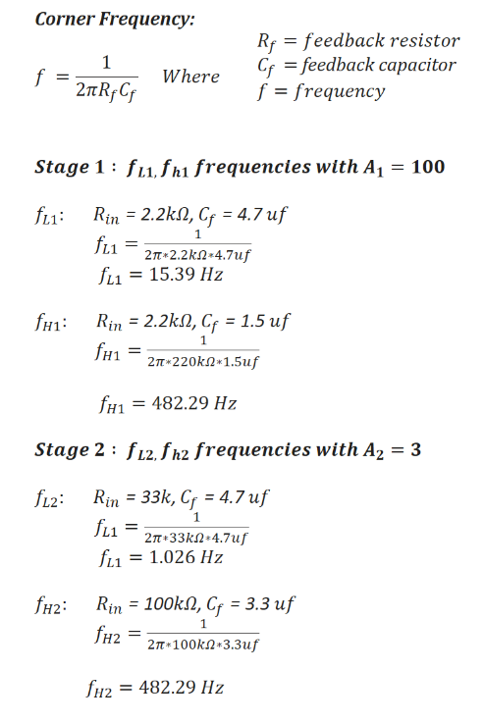
Calculations

Slide 4
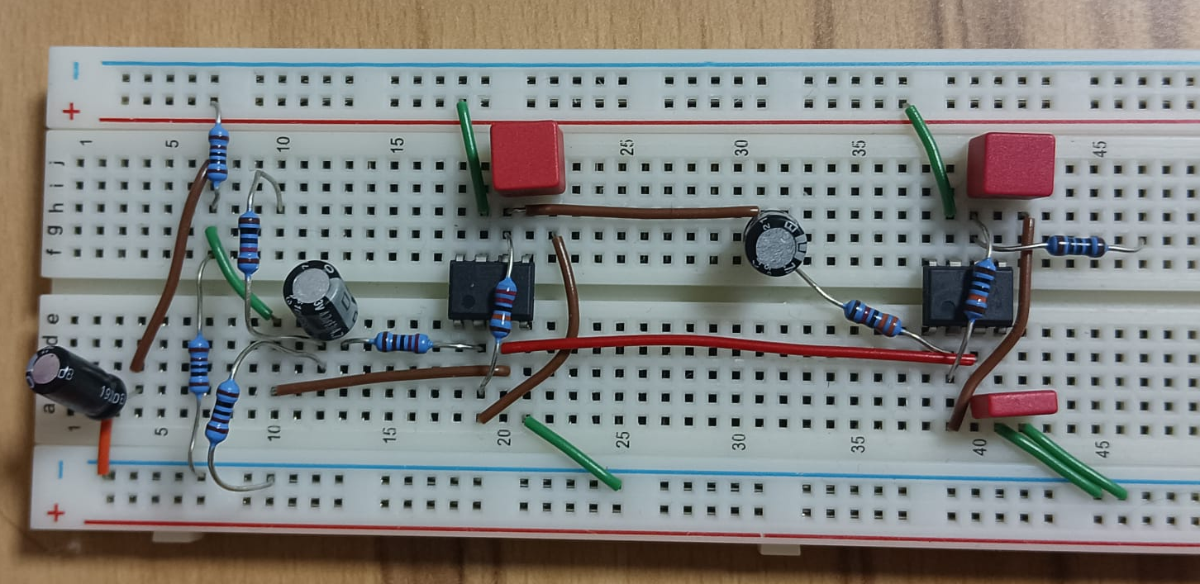
Breadboard Circuit

Slide 5
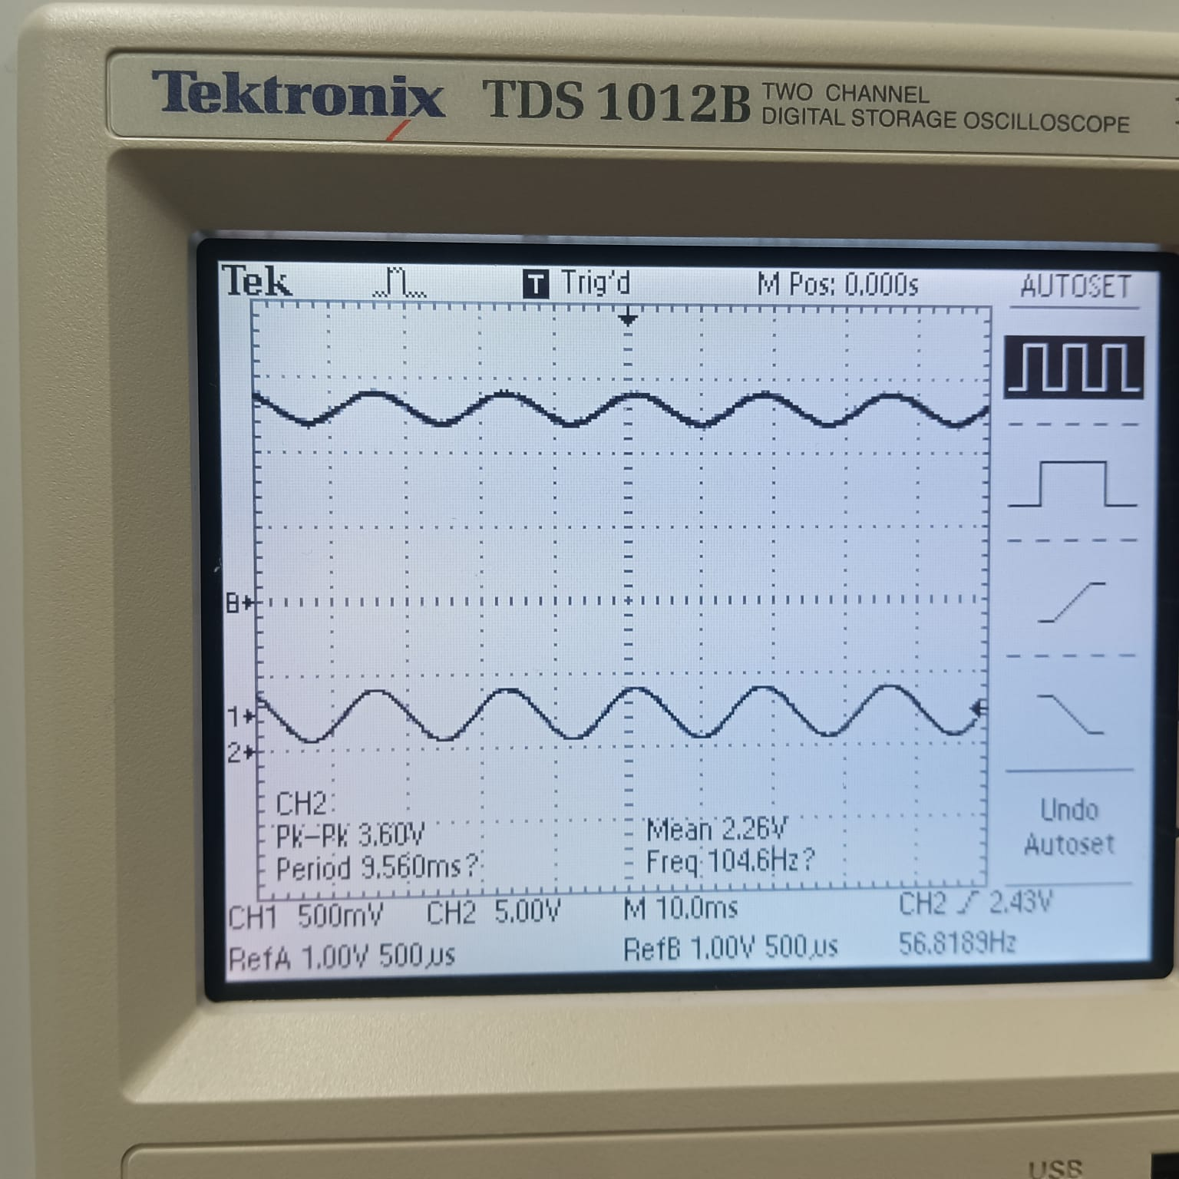
Amplifier Output

Slide 6
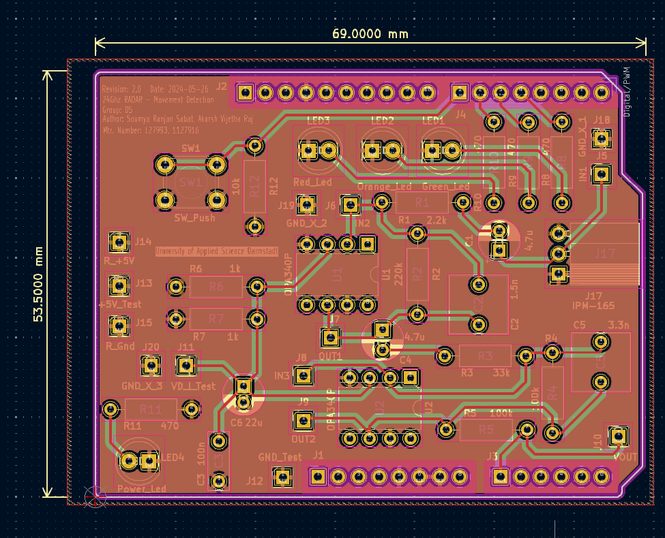
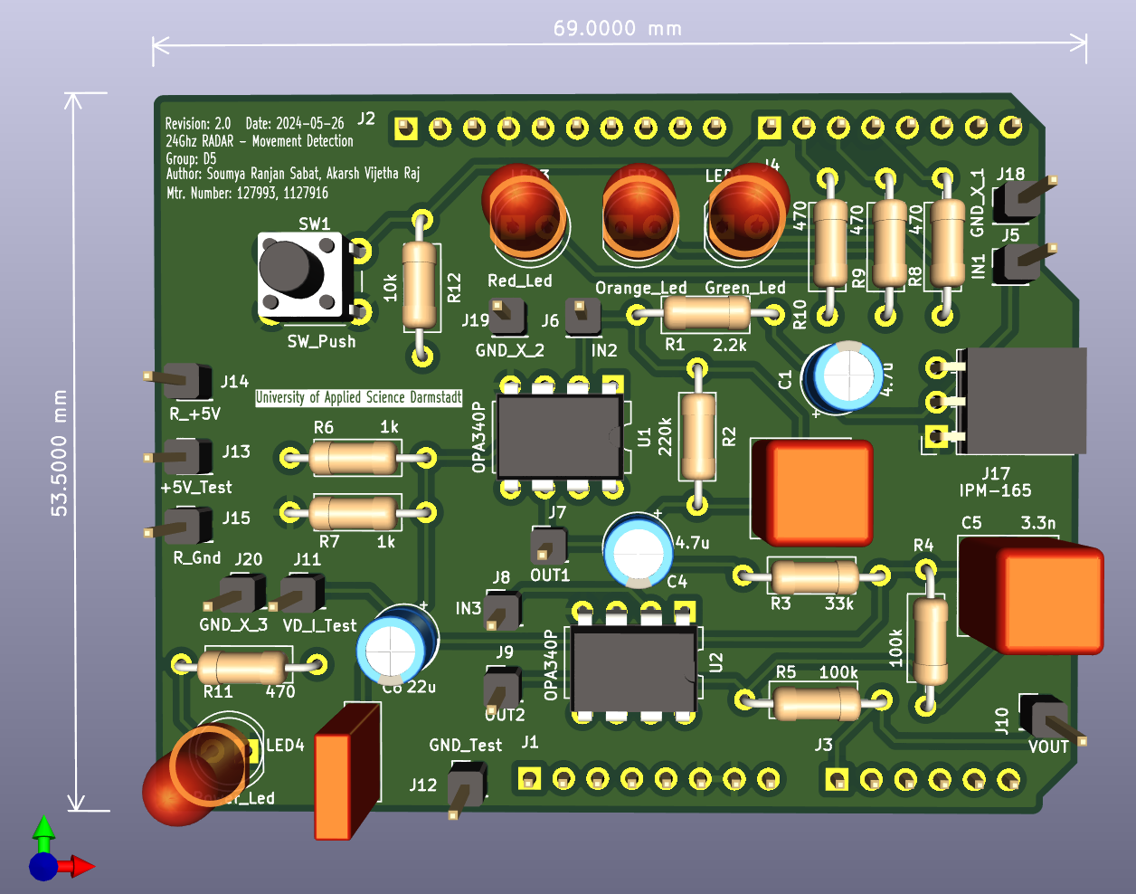
Layout

Slide 7
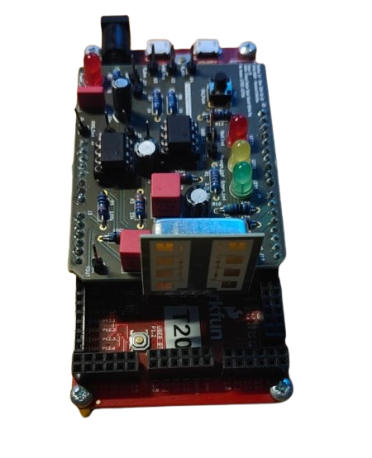
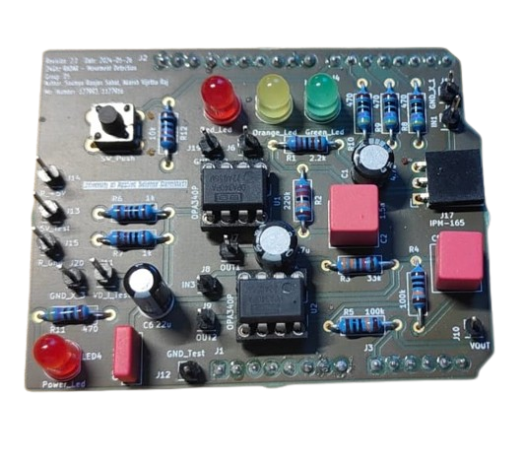
Hardware

Slide 8
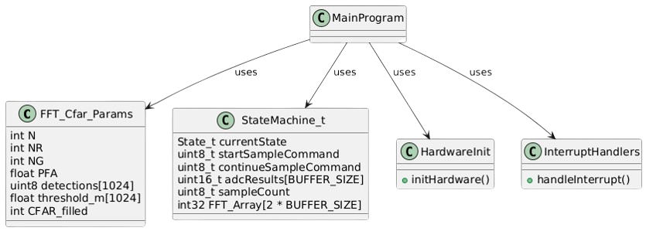
System UML

Slide 9
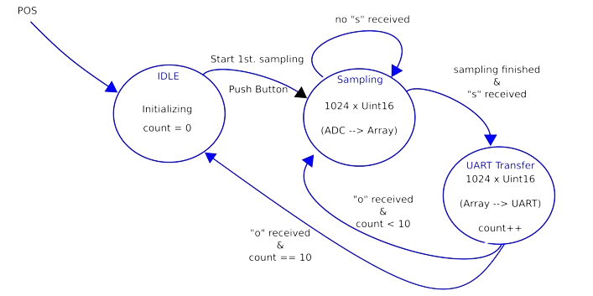
State Machine

Slide 10
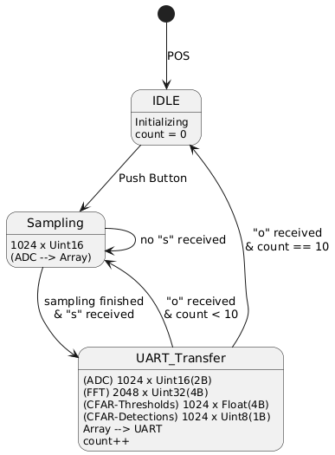
State Machine

Slide 11
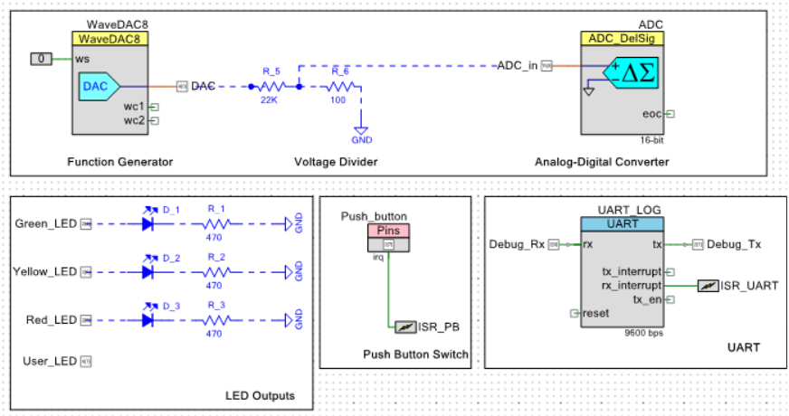
System Design

Slide 12
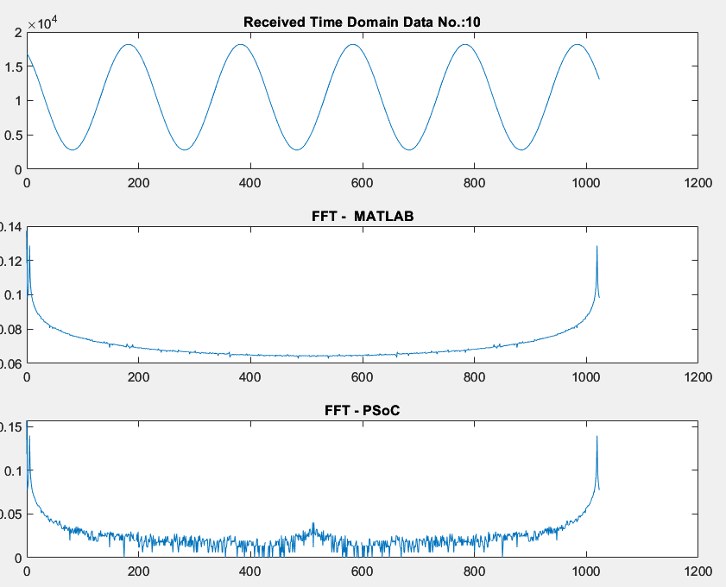
MATLAB Output
DAC - ADC

Slide 13
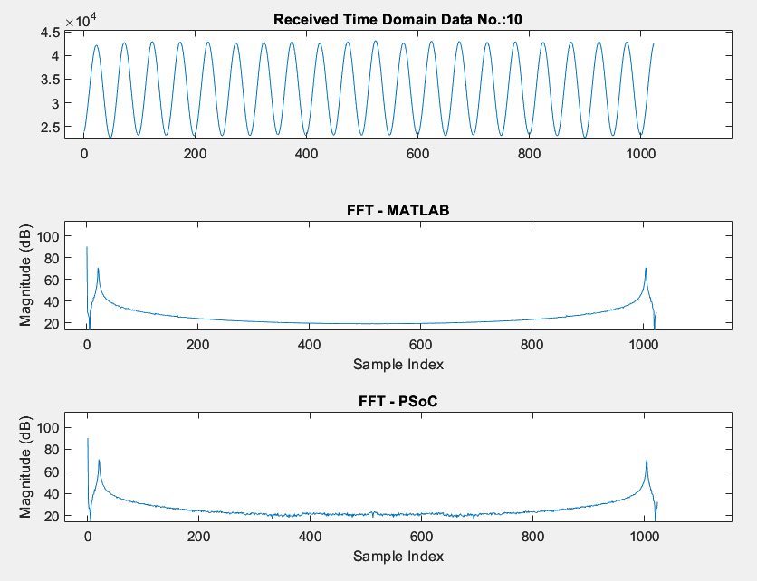
MATLAB Output - With Amplifier
DAC - Amplifier - ADC

Slide 14
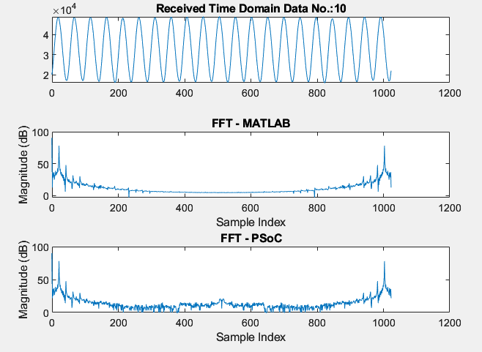
MATLAB Output - With Amplifier
Signal Generator - Amplifier - ADC

Slide 15
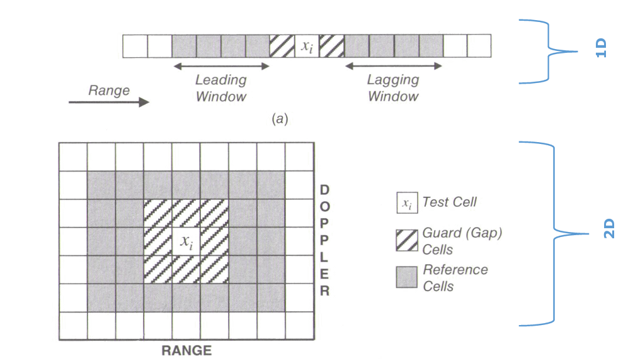
CFAR
Introduction to NG and NR
NG (Guard Cells):
Guard cells are placed adjacent to the Cell Under Test (CUT).
They act as a buffer zone to prevent the target signal from contaminating the noise estimate.
Typically, NG is chosen based on the expected width of the target signal in the frequency domain.
NR (Reference Cells):
Reference cells are used to estimate the noise level.
They are located on either side of the guard cells.
The number of reference cells affects the accuracy and reliability of the noise estimate.
NG = 1
NR = 5
 |  |  |  |  |  | Xi

Slide 16
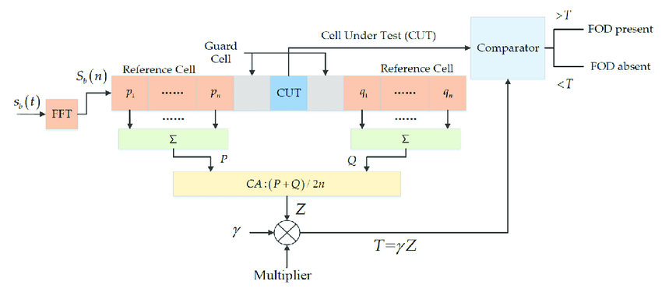
CA-CFAR Algorithm

Slide 17
Effects of NG and NR on CFAR Detection
Guard Cells (NG):
Too Few Guard Cells:
Insufficient separation between the target and noise estimation zones.
Potential contamination of the noise estimate with target signal energy.
Results in higher probability of false alarms (PFA).
Too Many Guard Cells:
Excessive separation reduces the number of available reference cells.
Potential reduction in the accuracy of the noise estimate.
Can lead to missed detections (lower Probability of Detection, PD).
Reference Cells (NR):
Too Few Reference Cells:
Poor noise estimation due to insufficient data.
Increased variability in the noise estimate.
Higher probability of false alarms or missed detections.
Too Many Reference Cells:
Improved noise estimation with more data.
More robust and stable threshold determination.
However, it can lead to increased computational complexity and processing time.

Slide 18
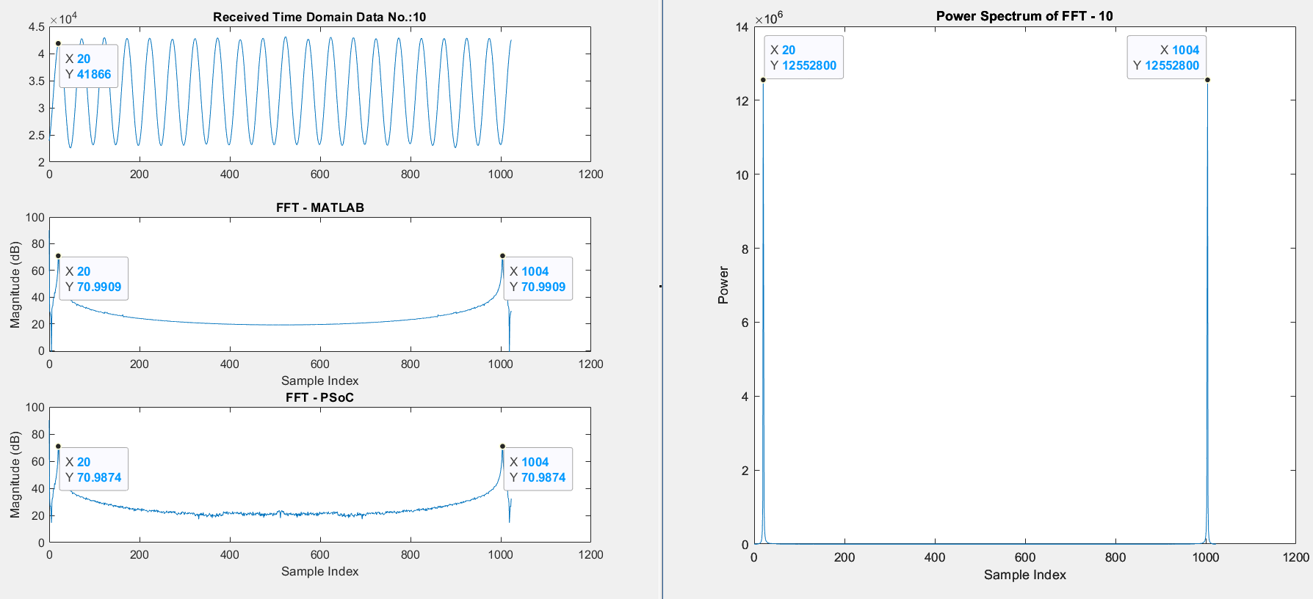

Slide 19
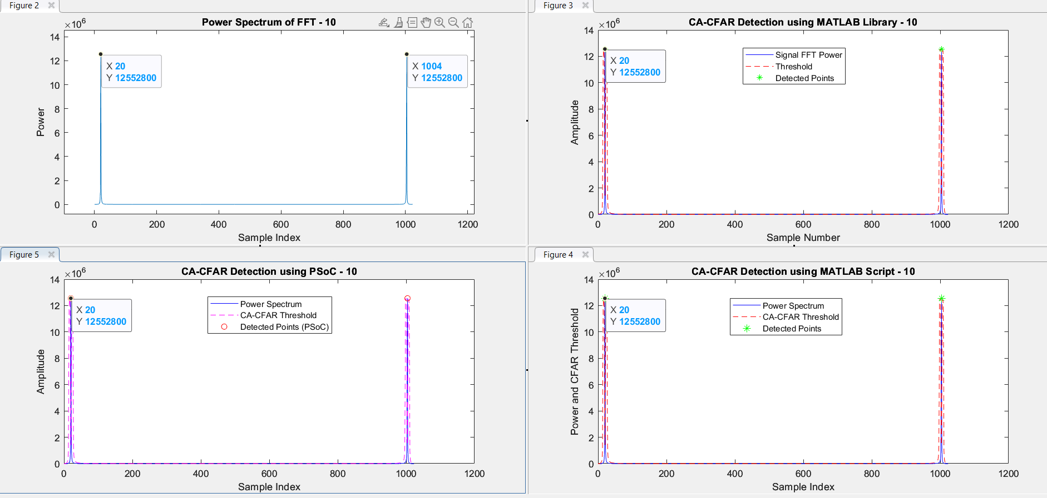

Slide 20
